Slide 1
Collier & Hubbard (2001)
Task: Explicit matching with Likert Scale
Pitch:
Sine waves @ 75 dB
High = 1046.4 Hz Low = 261.6 Hz
Speed:
Likert Scale
Fast = 7 Slow = 1
Result:
High-pitched tones rated as faster (z_{diff} = 0.44) than low-pitched tones
Pitch
Evans & Treisman (2011)
Task: Speeded Classification
Pitch:
Sine waves @ 75 dB
High = 1500 Hz Low = 1000 Hz
Size:
Circular visual gratings
Large= 6º visual Small = 3º visual
Result:
RT faster on congruent (High Pitch = Small) trials by 15 ms
High Pitch = Fast
High Pitch = Small
Speed
Size
Fast = Small
Yong & Hsieh (2017)
Task: Explicit 2 AFC Task- Which dot is faster?
Speed:
Movement traversing 6º visual angle
Fast= 160% ref Slow= 40% ref
Size:
White dots
Large= 2.5º visual Small = 1º visual
Result:
Smaller dots perceived to be equally as fast as reference at lower speeds than large dots

Slide 2








Hue: 196
Saturation: 100
Brightness: 95
Hex: #01B0F1
RGB: 1, 176, 241
Hue: 60
Saturation: 100
Brightness: 100
Hex: #FFFF01
RGB: 255, 255, 1
Hue: 0
Saturation: 100
Brightness: 100
Hex: #FE0000
RGB: 254, 0, 0
Hue: 120
Saturation: 100
Brightness: 100
Hex: #00FF01
RGB: 0, 255, 1
Hue: 196
Saturation: 99
Brightness: 64
Hex: #0178A2
RGB: 1, 120, 162
Hue: 59
Saturation: 100
Brightness: 74
Hex: #BCB800
RGB: 188, 184, 0
Hue: 0
Saturation: 100
Brightness: 64
Hex: #A40000
RGB: 164, 0, 0
Hue: 120
Saturation: 100
Brightness: 66
Hex: #01A800
RGB: 1, 168, 0

Slide 3








Hue: 0
Saturation: 100
Brightness: 100
Hex: #FE0000
RGB: 254, 0, 0
Hue: 0
Saturation: 100
Brightness: 100
Hex: #FE0000
RGB: 254, 0, 0
Hue: 0
Saturation: 100
Brightness: 100
Hex: #FE0000
RGB: 254, 0, 0
Hue: 60
Saturation: 100
Brightness: 100
Hex: #FFFF01
RGB: 255, 255, 1
Hue: 196
Saturation: 100
Brightness: 95
Hex: #01B0F1
RGB: 1, 176, 241
Hue: 120
Saturation: 100
Brightness: 100
Hex: #00FF01
RGB: 0, 255, 1
Hue: 60
Saturation: 100
Brightness: 100
Hex: #FFFF01
RGB: 255, 255, 1
Hue: 196
Saturation: 100
Brightness: 95
Hex: #01B0F1
RGB: 1, 176, 241

Slide 4









Slide 5
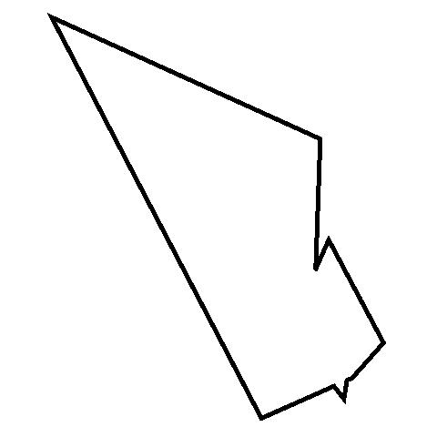

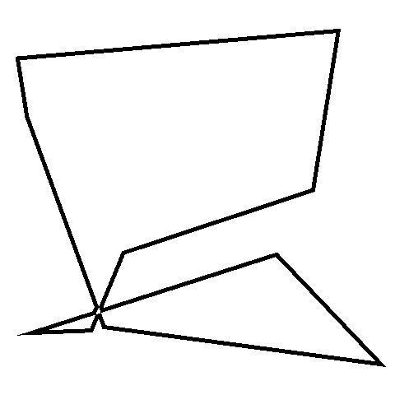

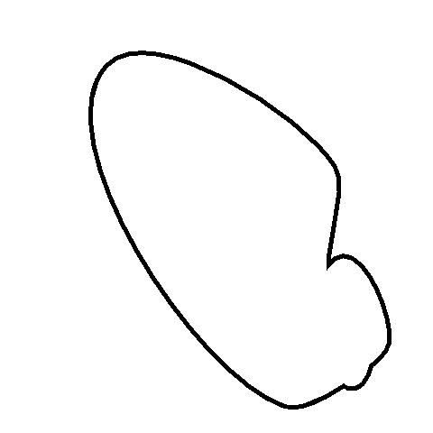




Slide 6






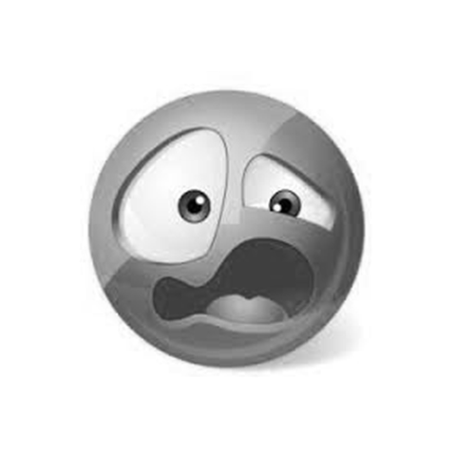
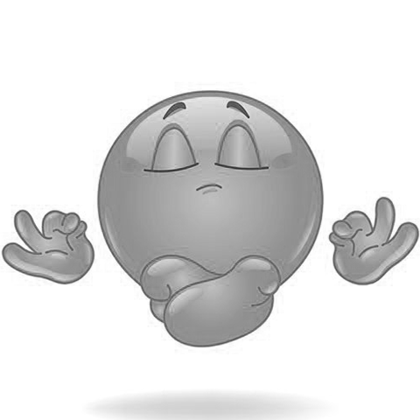
Happy
Excited
Pleased
Stressed
Sad
Bored
Disgusted
Calm

Slide 7
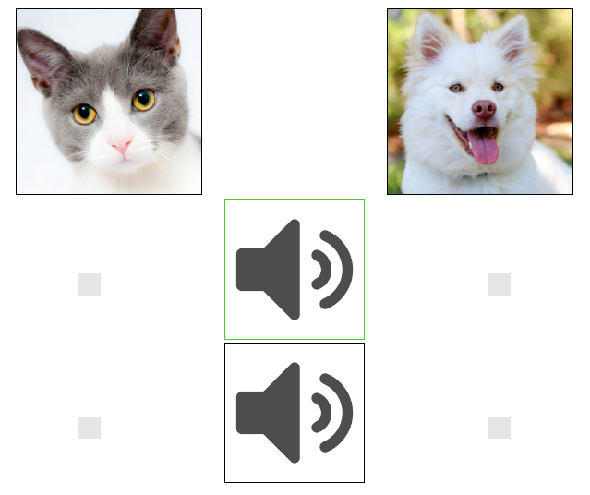
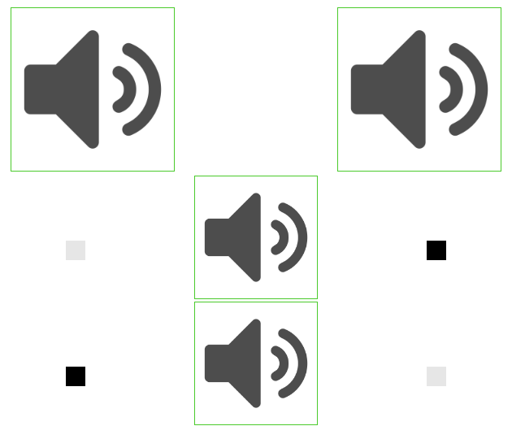
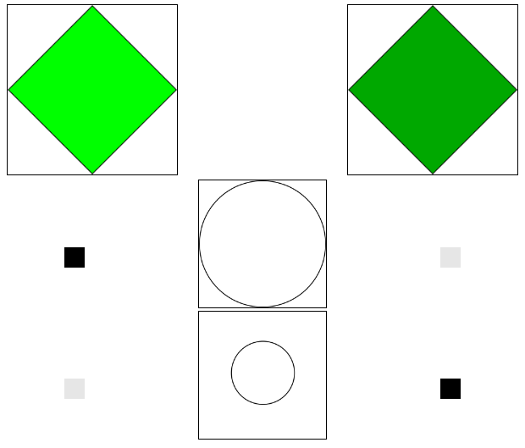
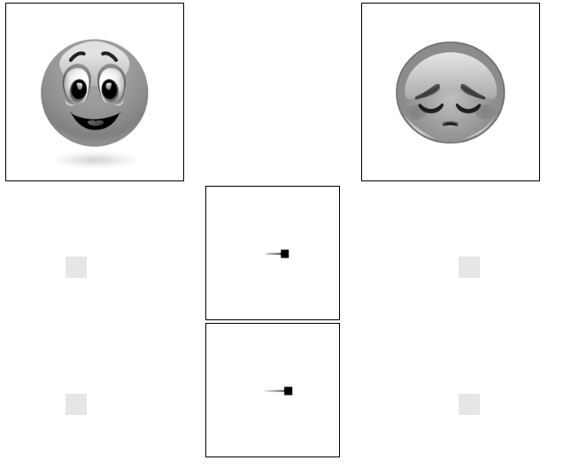
A
B
C
D

Slide 8
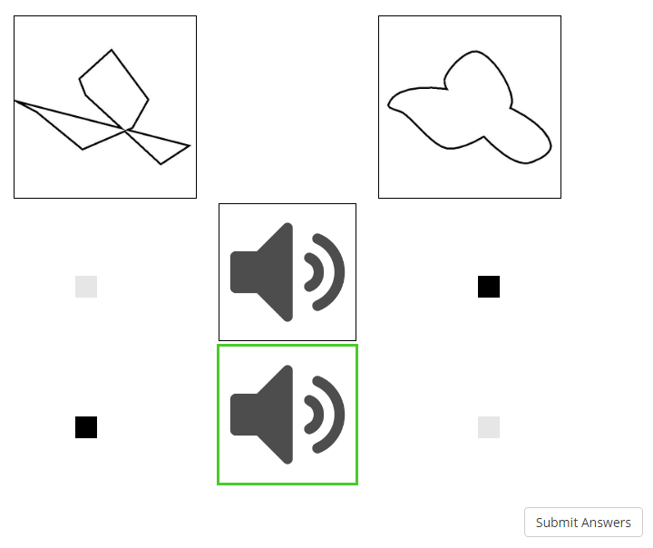
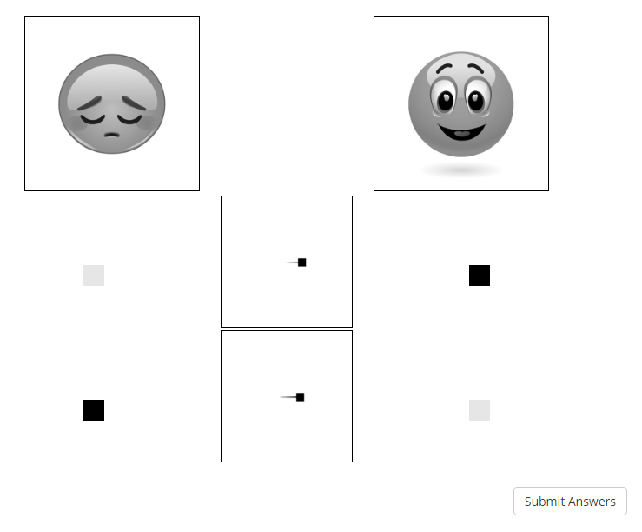
A
B

